Slide 1

XR-
Raspberry pi
Development environment installation
--Ubuntu mate
深圳市小二极客科技有限公司
www.wifi-robots.com

Slide 2
Catalog
1.Ubuntu mate system installation and setup
2.Development environment installation
www.wifi-robots.com

Slide 3
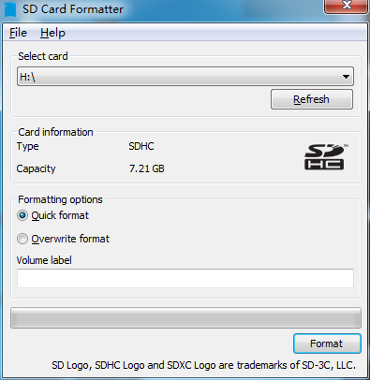
Ubuntu mate system installation and setup
1、Download Ubuntu-mate image：https://ubuntu-mate.org/raspberry-pi/
Download SDFormatterv4：https://www.sdcard.org/downloads/formatter_4/
Download Win32DiskImager：https://sourceforge.net/projects/win32diskimager/
2、Prepare a 8G TF Card ，Use SDFormatterv4 to formate the TF card
www.wifi-robots.com

Slide 4
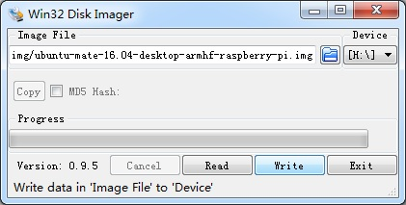
Ubuntu mate system installation and setup
3、Use Win32DiskImager to flash the ubuntu-mate image（ubuntu-mate-16.04-desktop-armhf-raspberry-pi.img）to TF card.
Run Win32DiskImager，and find your image location，then click ‘Write’to download the system
www.wifi-robots.com

Slide 5
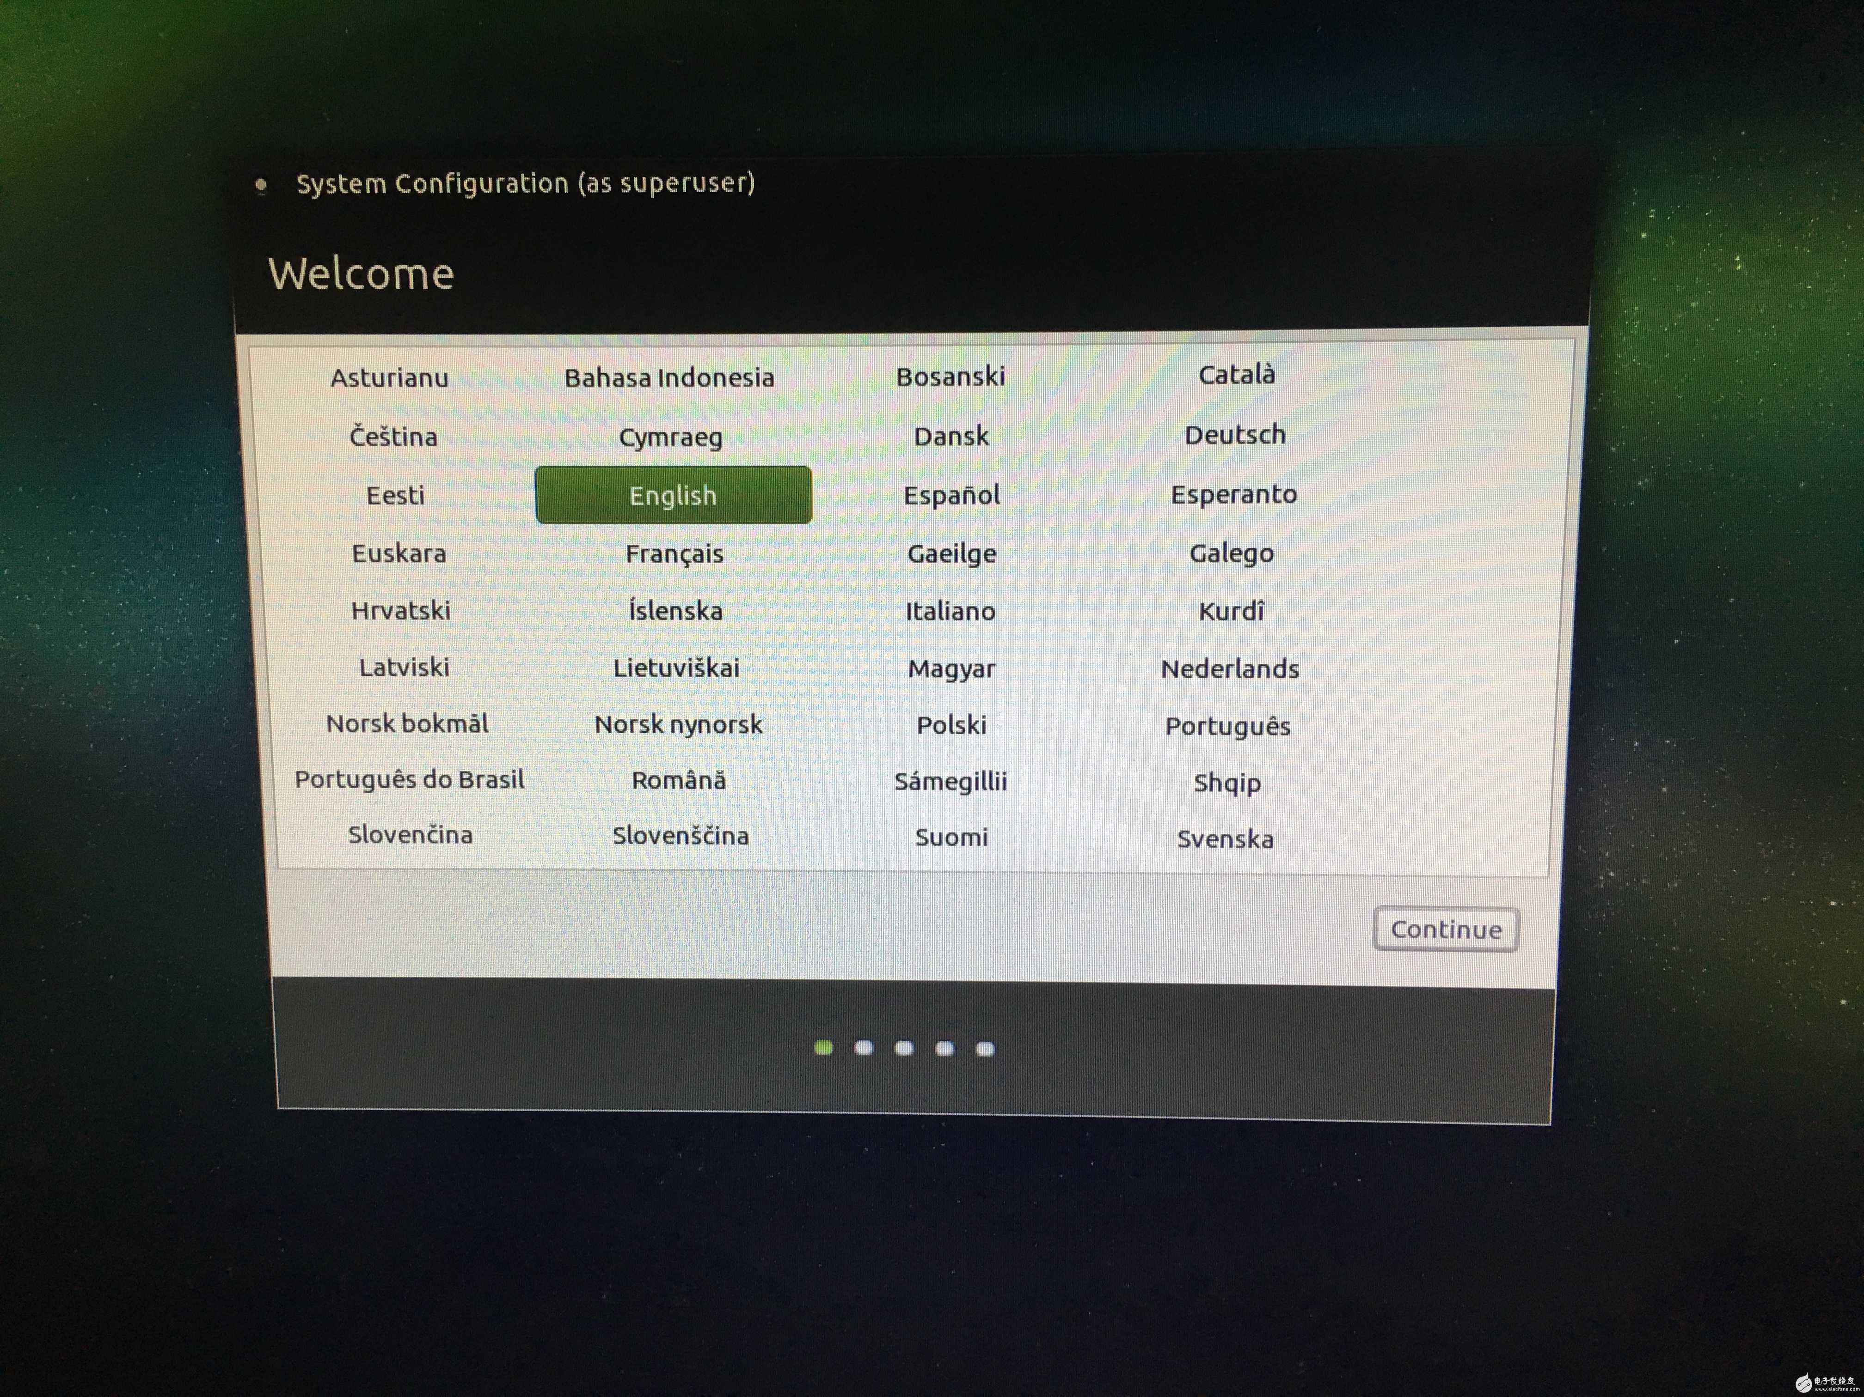
Ubuntu mate system installation and setup
4、 inserted the TF card into the raspberry,and power on the switch
First ,you should set the language
www.wifi-robots.com

Slide 6
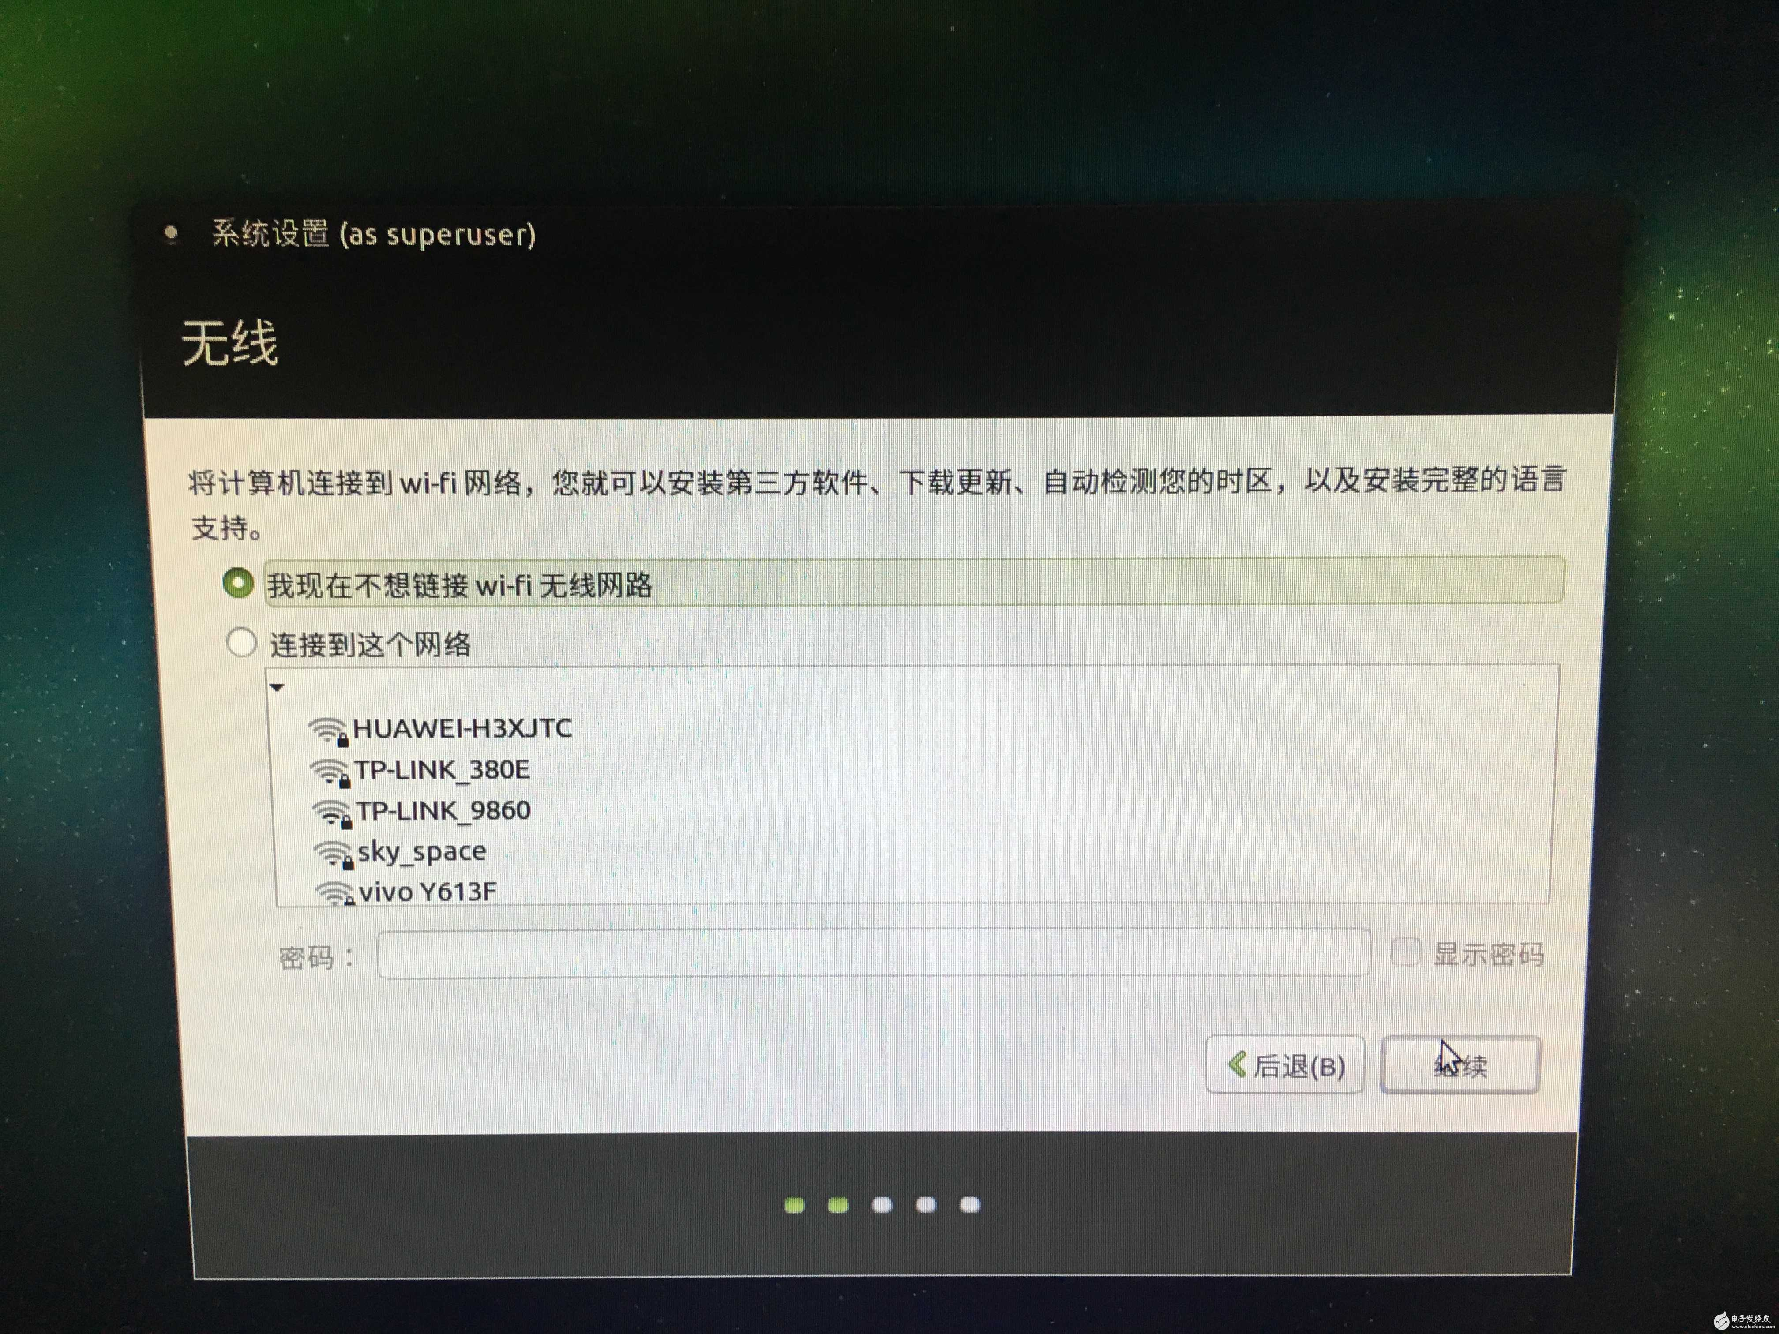
Ubuntu mate system installation and setup
WiFi config：
www.wifi-robots.com

Slide 7
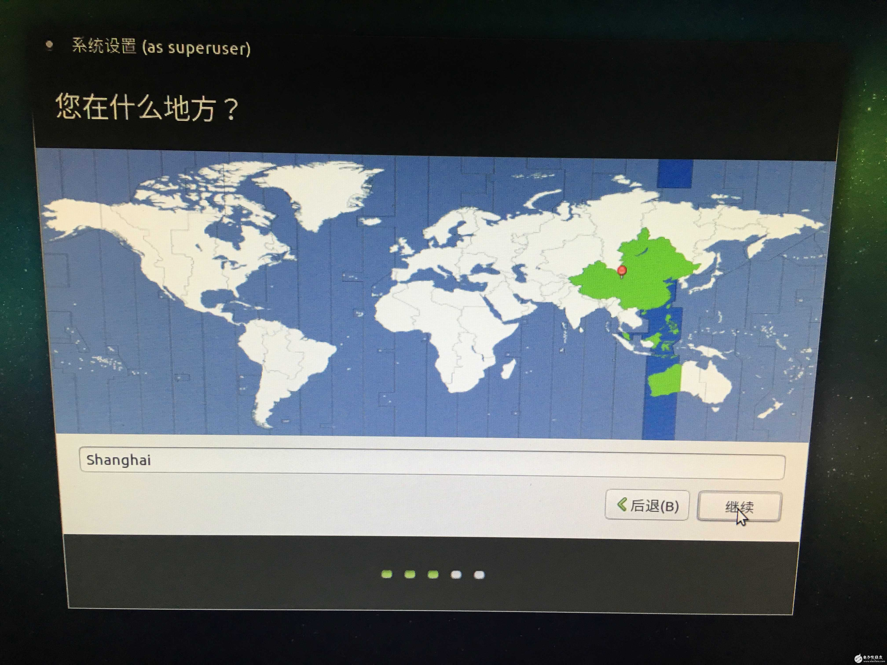
Time area config：
www.wifi-robots.com

Slide 8
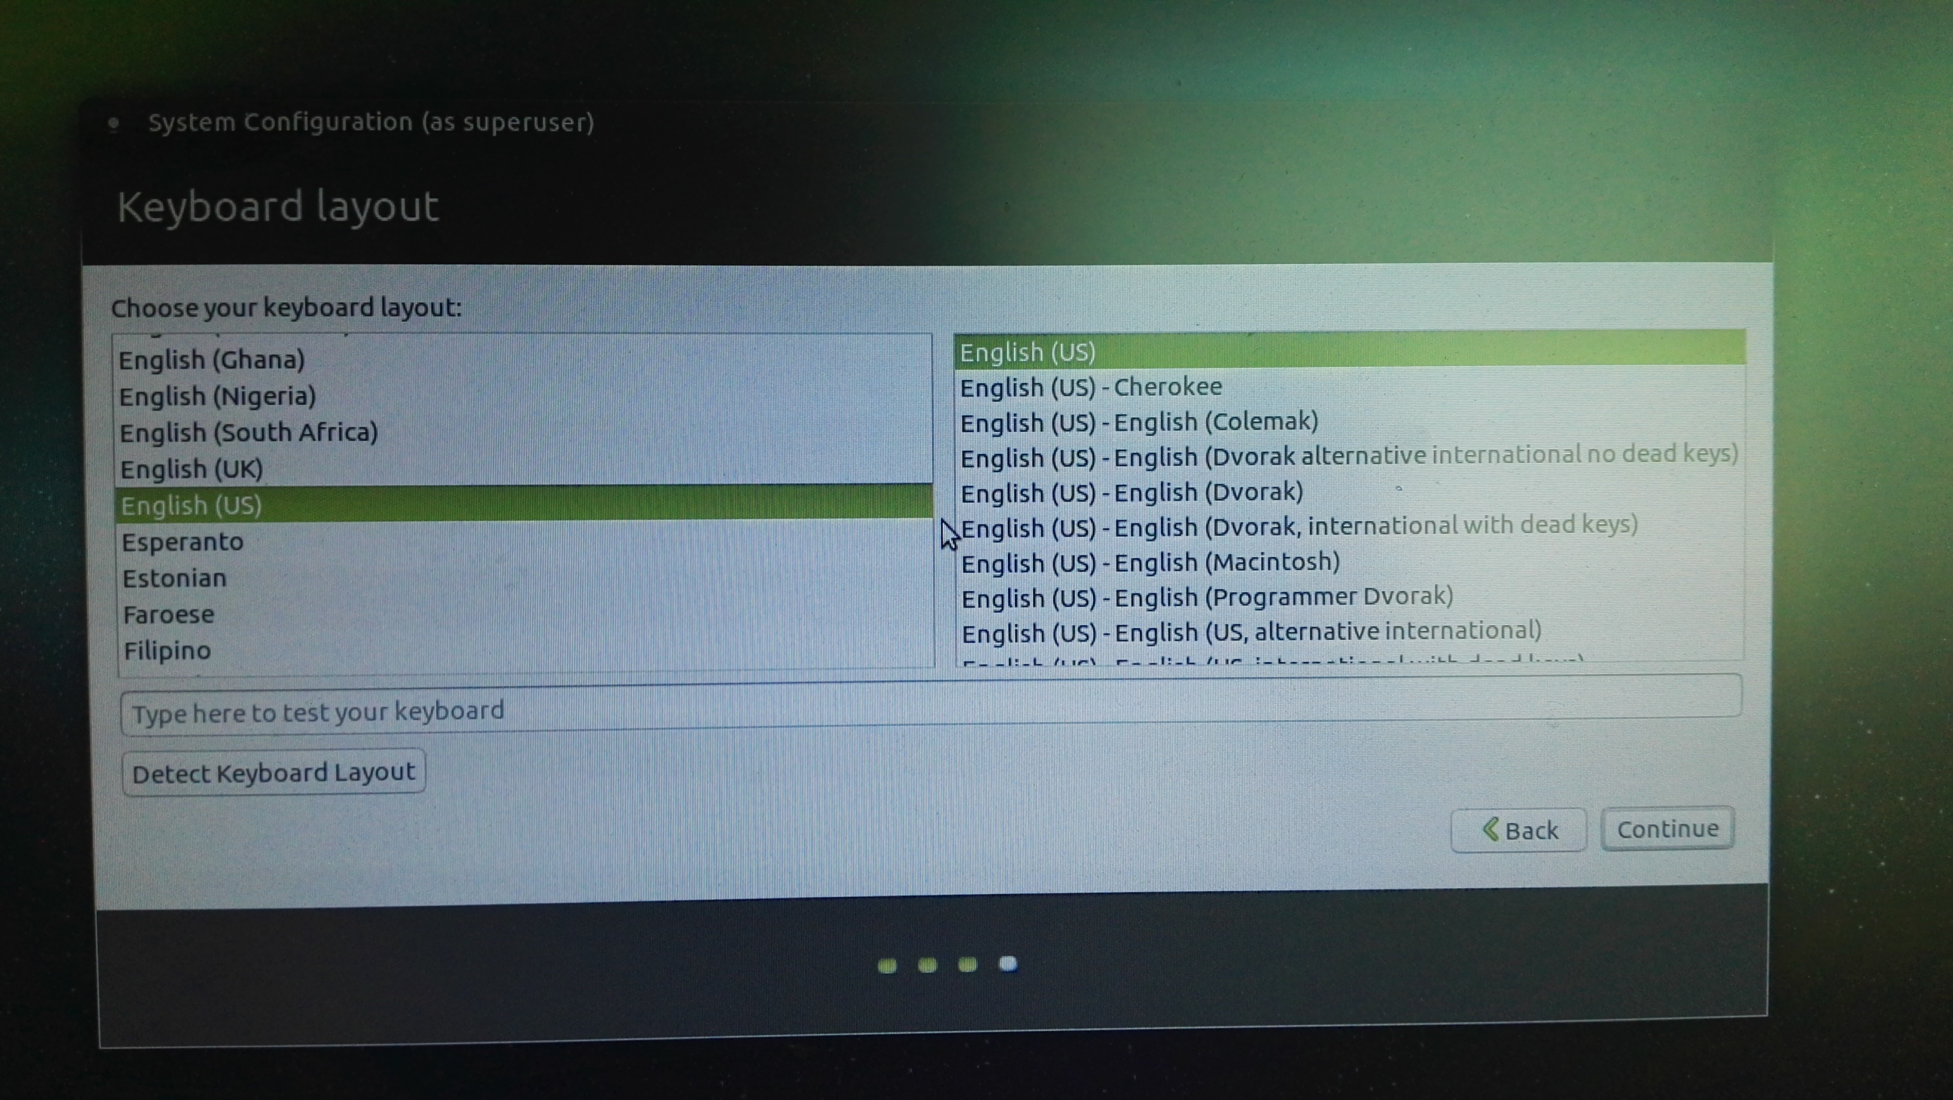
Ubuntu mate 系统的安装和设置
选择键盘种类：
www.wifi-robots.com

Slide 9
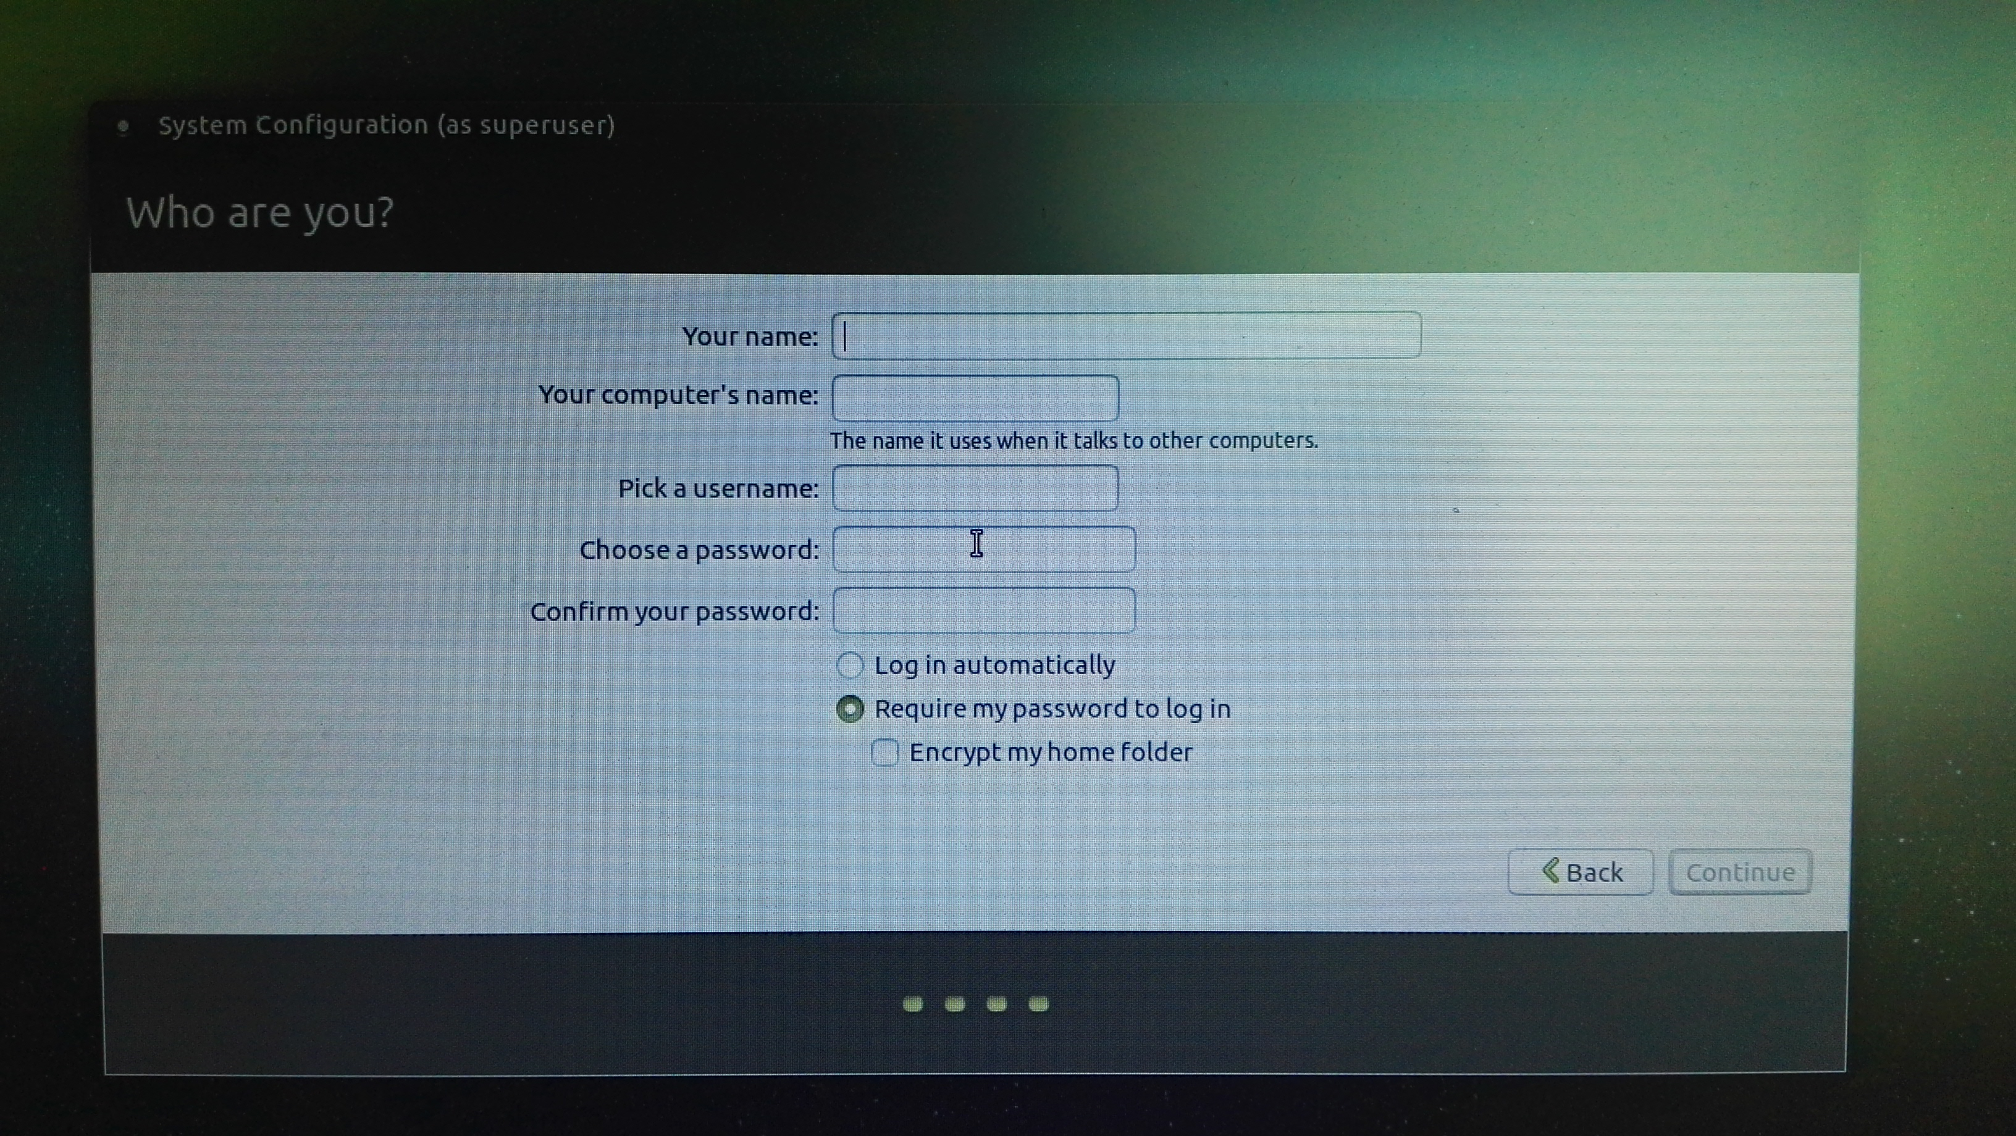
User and Password config
www.wifi-robots.com

Slide 10
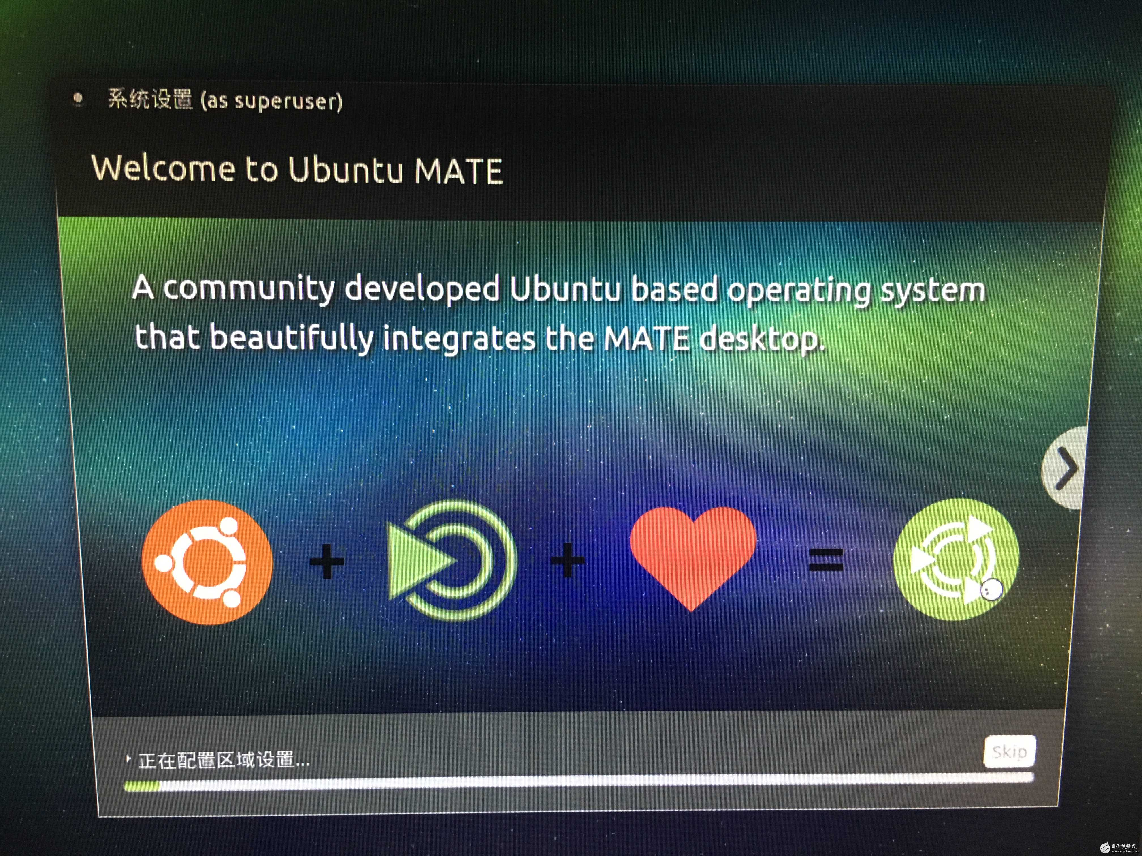
Click continue and wait for minutes
www.wifi-robots.com

Slide 11
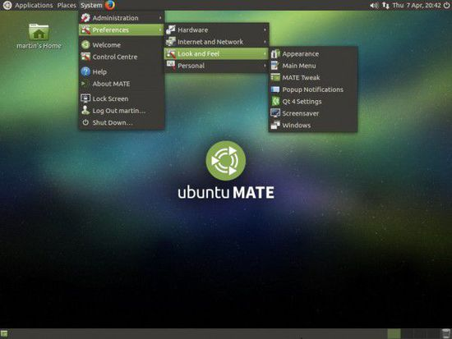
Ubuntu mate Desktop
www.wifi-robots.com

Slide 12
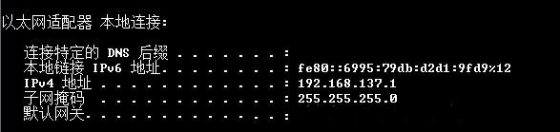
Check your IP address in your PC
www.wifi-robots.com

Slide 13
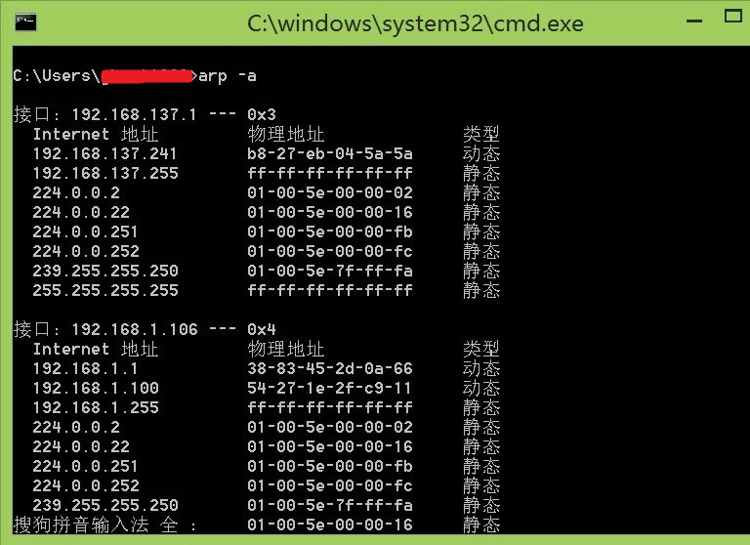
Use arp –a to check Pi’s IP address.
www.wifi-robots.com

Slide 14
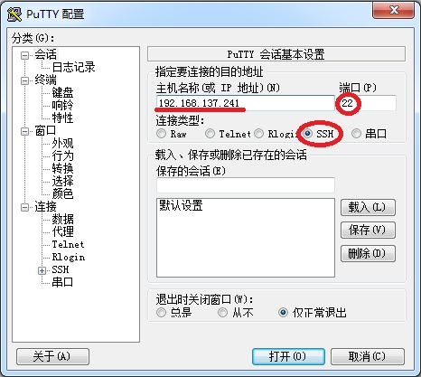
Install the Putty tool to connect Pi
www.wifi-robots.com

Slide 15
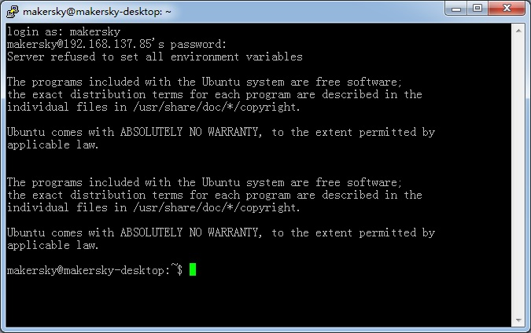
When you log on for the first time, you will be prompted to confirm the connection key. Press "yes" to confirm that this is the only way to sign up for the first time. Login will prompt to enter the user name and password, please enter the user name and password set up just installed the system, you can log in after entering the pi command line:
www.wifi-robots.com

Slide 16
Update the system： sudo apt-get update 2.install pip sudo apt-get install python3-pip 3.get GPIO lib
sudo pip-3.2 install RPi.GPIO
www.wifi-robots.com

Slide 17
END
深圳市小二极客科技有限公司
www.wifi-robots.com

